Slide 1
x
f(0,0) | f(1,0) | f(2,0) | f(3,0) | f(4,0)
f(0,1) | f(1,1) | f(2,1) | f(3,1) | f(4,1)
f(0,2) | f(1,2) | f(2,2) | f(3,2) | f(4,2)
f(0,3) | f(1,3) | f(2,3) | f(3,3) | f(4,3)
f(0,4) | f(1,4) | f(2,4) | f(3,4) | f(4,4)
y

Slide 2
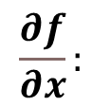
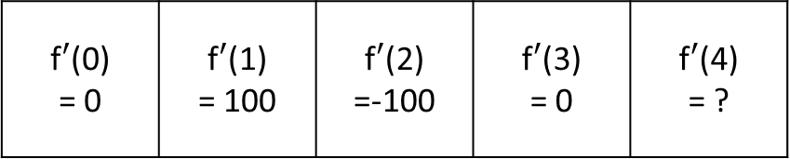

x
f(0) = 100 | f(1) = 100 | f(2) =200 | f(3) = 100 | f(4) = 100
$$f(x):$$
x
f$′$(0) = 0 | f$′$(1) = 100 | f$′$(2) =-100 | f$′$(3) = 0 | f$′$(4) = ?
$$\frac{∂f}{∂x}:$$

Slide 3
Pixel_Buffer
1
2
3
buf_data
4
5x5 8bit Shift Reg
Debay
5
Linie 4 A
Linie 3 A
Linie 2 A
Linie 1 A
Linie 4 B
Linie 3 B
Linie 2 B
Linie 1 B
Buffer A or B
4x8 FiFo A
4x8 FiFo B

Slide 4
Bild Mux
D
Q
>
D
Q
>

Slide 5
Ist Zustand Perske
camera tapping base
CAM Data Mux
SDRAM Write Buffer
Memory Access Control
SDRAM Controler
CAM
SDRAM Read Buffer
SDRAM Pixel Buffer
Debay
Convo-lution
VGA

Slide 6
Neuer Zustand
Memory Access Control
CAM Data Mux
SDRAM Write Buffer
SDRAM Controler
SDRAM Read Buffer
CAM
SDRAM Pixel Buffer
Debay
Convo-lution
LINE_ DETECTION_CONV
OBJECT_
DETECTION
VGA

Slide 7
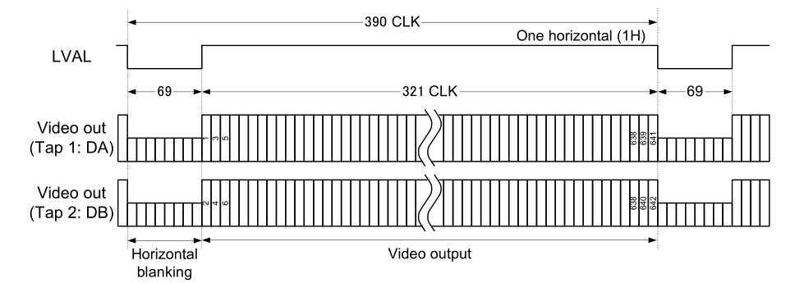
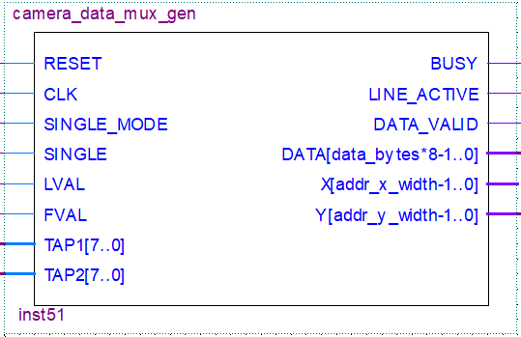

Slide 8
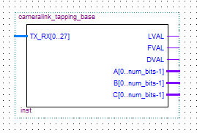
Camera Link Daten 28-bit
Steuersignale
TAP2
TAP3

Slide 9
